Slide 1
Laboratory Real-time Audio Processing
RTProc Getting Started Workshop
Daniel Haupt
IKS Lecture

Slide 2
1 Introduction
Real-time Audio Processing based on Software Framework RTProc 2.0
Software Framework RTProc
Tool for rapid development of real-time prototypes
Why not Program an Audio Processing Application from Scratch?
Since that is more effort than time is available in our laboratory!
Better: Re-use of common functional components
Better: Follow a specific design/develop process and philosophy
What Lesson to Learned Today
Create your first audio processing application
Example: build a stereo panning algorithm

Slide 3

Development Philosophy
idea
Development Phase I
Development Phase II
Development Phase III
Algorithm Investigation
High level programming language (Matlab)
Offline Processing
Convenient programming
Inefficient implementation (no real-time execution)
Real-time Evaluation
Programming lang. C/C++
Optimized computational complexity
Real-time version
Efficient implementation
Difficult programming
Product Integration
(DSP hardware)
C/C++ or Assembler
Hardware specific Optimization
Even more difficult programming
Development Timeline
idea
Real-time Demonstrator
(PC based)
product

Slide 4
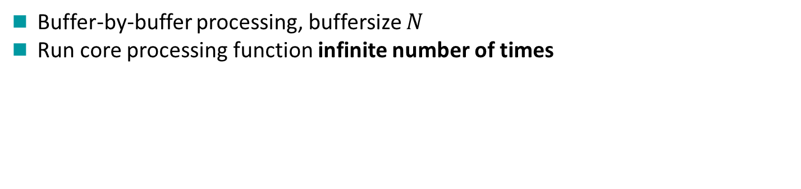
What Audio Processing Algorithms have in Common
Process Input Samples to Produce Output Samples
Process Input Samples to Produce Output Samples in Real-time
Buffer-by-buffer processing, buffersize $N$
Run core processing function infinite number of times

Slide 5
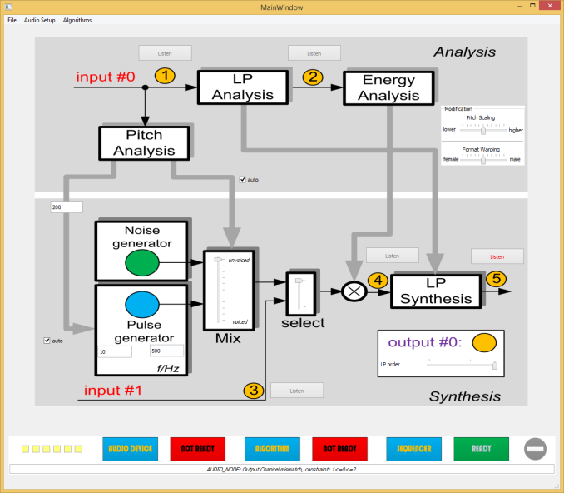
Goal of This Workshop
Create Your First Real-time Audio Processing Application
Signal Processing Core Functionality with Graphical User Interface (GUI)
User Interaction
Control & Monitoring
Signal Processing
Core Processing

Slide 6
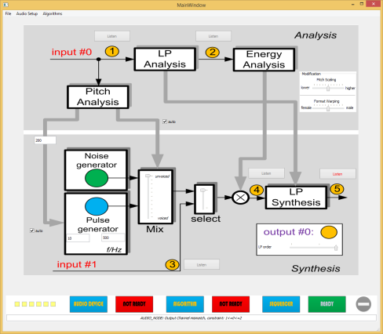
What else Will You Learn?
Propagate through typical development phases …
Matlab
C/C++
Development Timeline

Slide 7
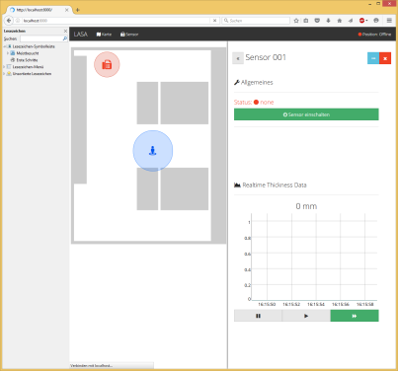
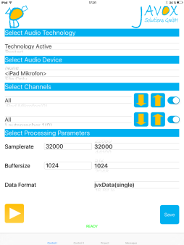
What else is Possible?
.. and we will advice you about what else is possible if desired!
C/C++
C/C++ + JSCRIPT
C/C++ + Obj-C on iOS
Development Timeline

Slide 8
Part I
The Build Environment

Slide 9
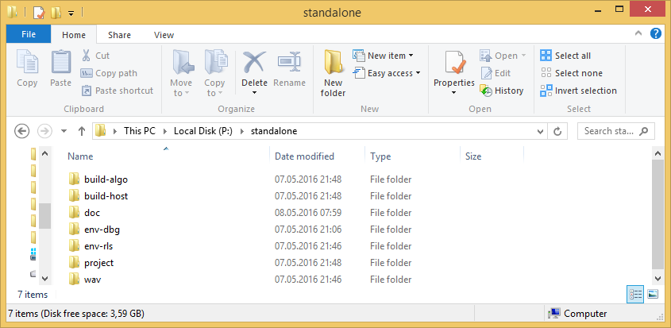
RTProc Project Distribution
All Files for the Creation of New Audio Processing Algorithms
Located in folder
P:\standalone

Slide 10
The RTProc Runtime and SDK Environment (I)
RTProc Runtime and SDK (Software Development Kit) Environment
Environment located in subfolder
env-dbg for „debug build“ and env-rls for „release build“

Slide 11
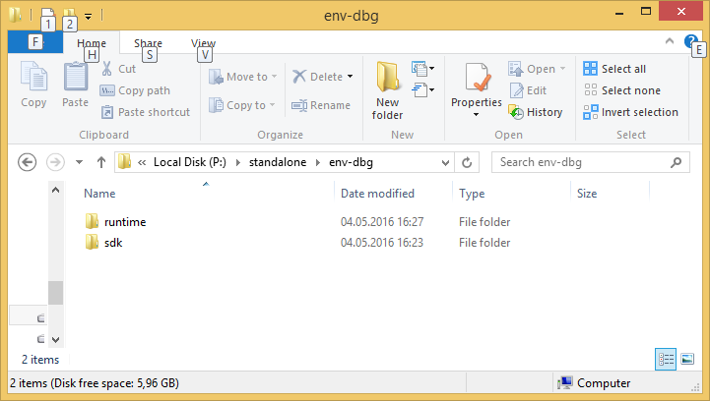
The RTProc Runtime and SDK Environment (II)
RTProc Runtime and SDK Environment
Runtime environment in subfolder runtime
SDK environment in subfolder sdk

Slide 12
The RTProc Runtime and SDK Environment (III)
Runtime Environment
Directory contains all Executables and similar, e.g.,
Audio processing host start scripts
Dynamic link libraries
System relevant runtime libraries such as Qt
SDK Environment
Directory contains all Files required for Building Executables, e.g.,
Static libraries
System header files
Templates and code fragments
Build files

Slide 13
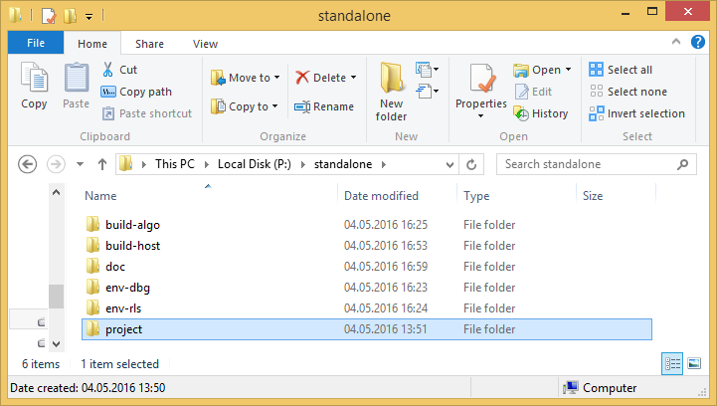
Files for the Creation of the First Application (I)
The Project Files
Projects located in subfolder project

Slide 14
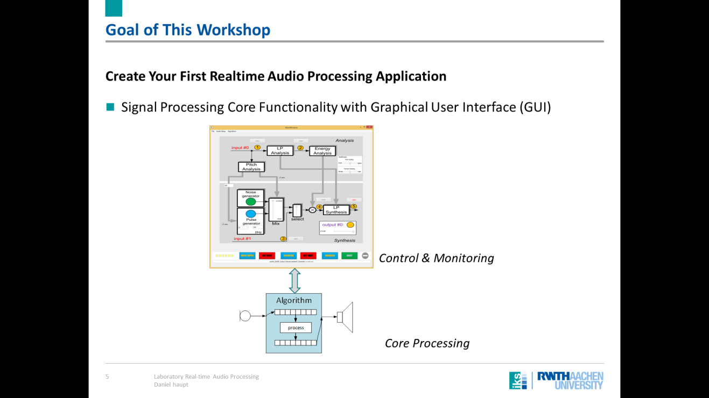
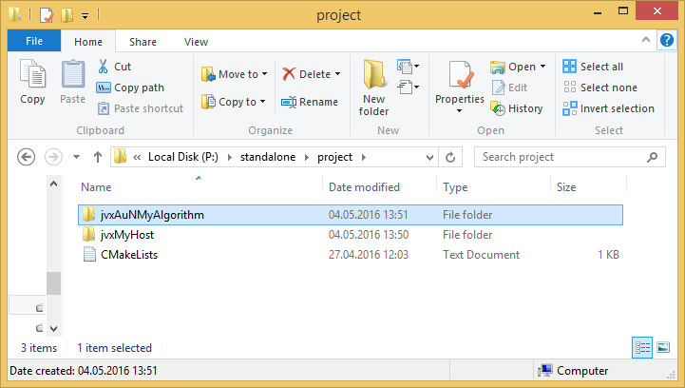
Files for the Creation of the First Application (II)
Core Signal Processing Component
Located in folder jvxAuNMyAlgorithm

Slide 15

Files for the Creation of the First Application (III)
Graphical User Interface (GUI) based on QT Audio Host
Located in folder jvxMyHost

Slide 16
Part II
Let us start…

Slide 17
Definition of an Example Project
Real-time Panning for Stereo Rendering
Principle Block Diagram
Single input channel
Input distributed to left and right output channel
Apply gain factor to control perceived steering
Desired Real-time control
Parameter ANGLE to control steering [in degree]
Parameter CFAC to control steering depth [0 .. 1.0]

Slide 18
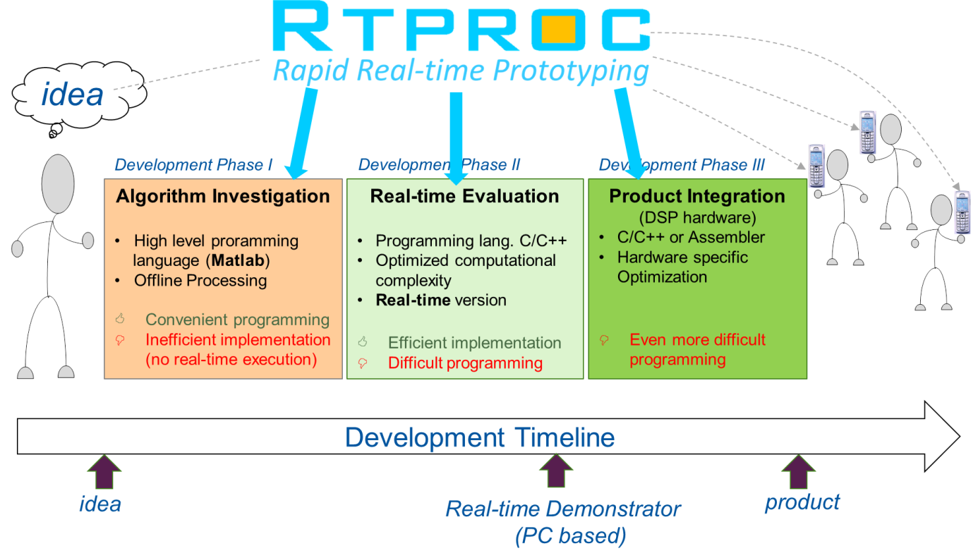
Remember This?
What will be next…
Version
Version
3
1
Version
2

Slide 19
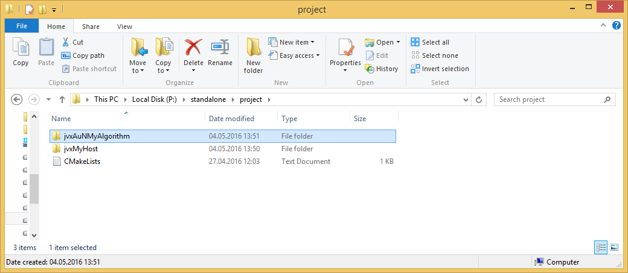
First Focus on..
The signal Processing Core Component
Remember: Files organized in folder jvxAuNMyAlgorithm
Take a look inside the project…

Slide 20
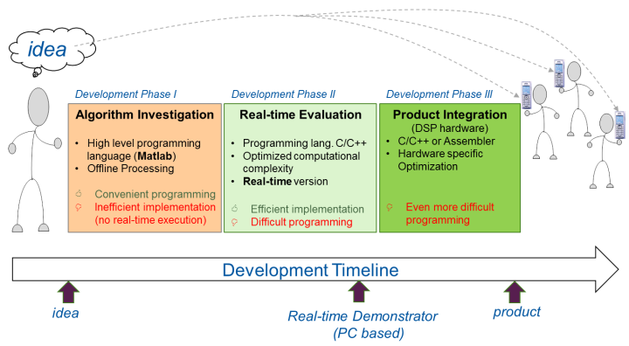
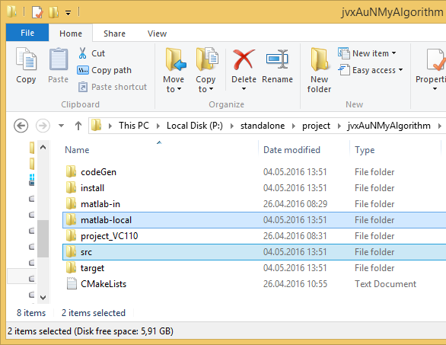
Code Components of the Template Project (II)
Provided Source Code Files
1
2
Different sub folders for different purposes
Folder to store Matlab implementation
1) „first time algorithm exploration“
Folder to store C/C++ implementation
2) „towards final realization“

Slide 21
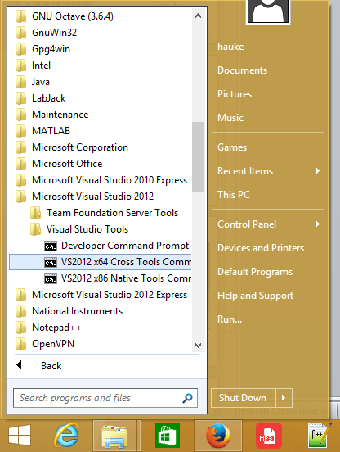
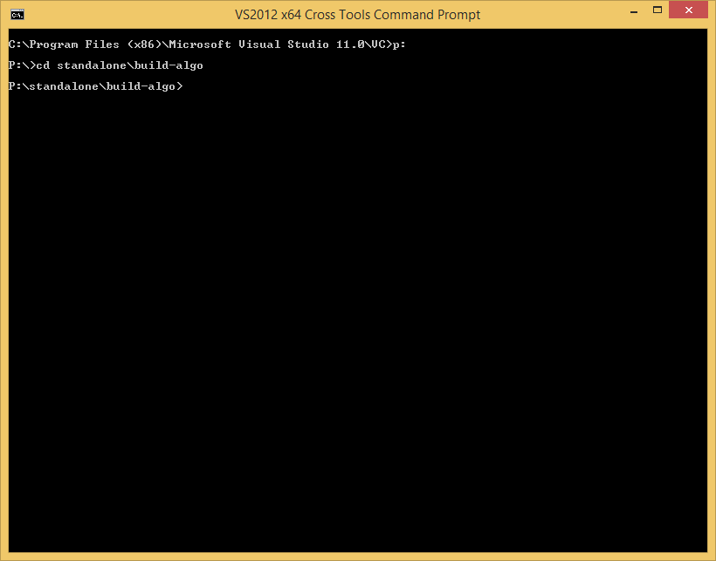
Setting up the Template Project (I)
First, Build Your Project Template
Open Visual Studio Command Prompt (64 Bit)
Go to folder
P:\standalone\build-algo

Slide 22
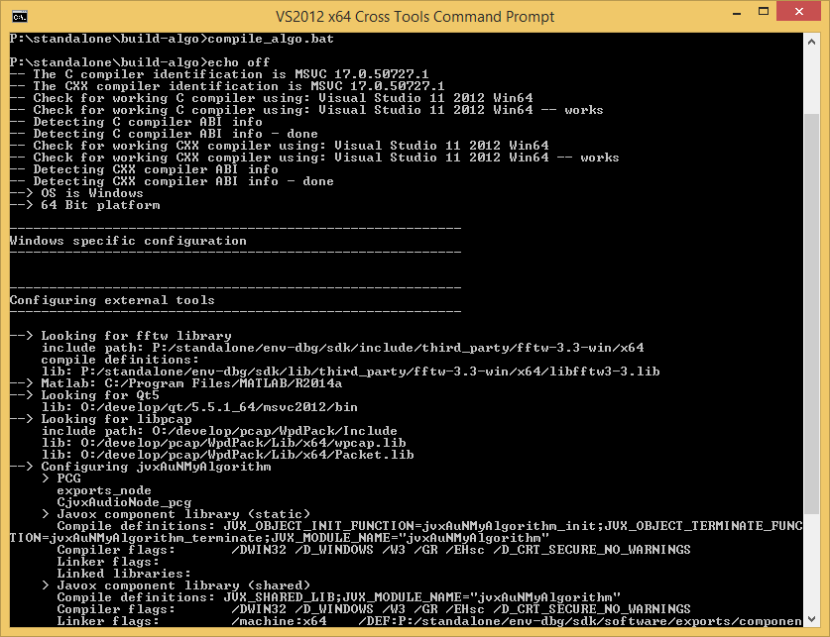
Setting up the Template Project (II)
Next, Create the Visual Studio Solution
Run cmake build script
compile_algo.bat

Slide 23
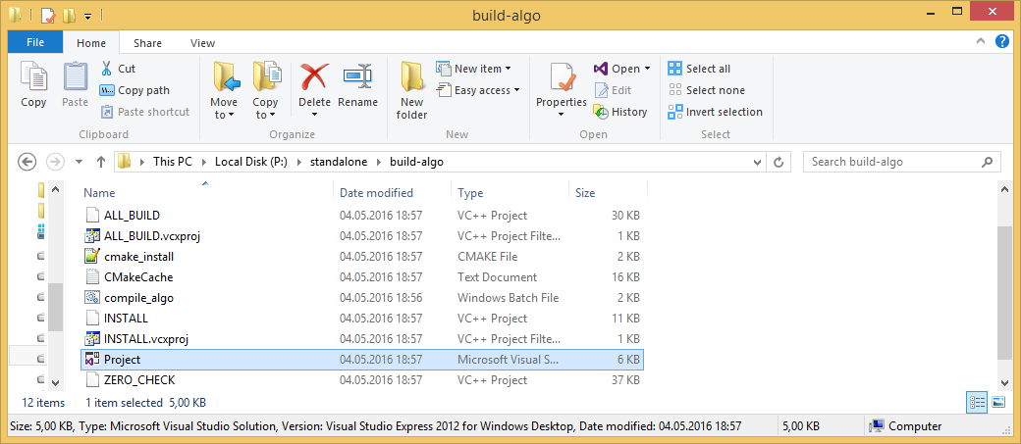
Setting up the Template Project (III)
Open Visual Studio
Double-click new Visual Studio Solution
Project.sln

Slide 24
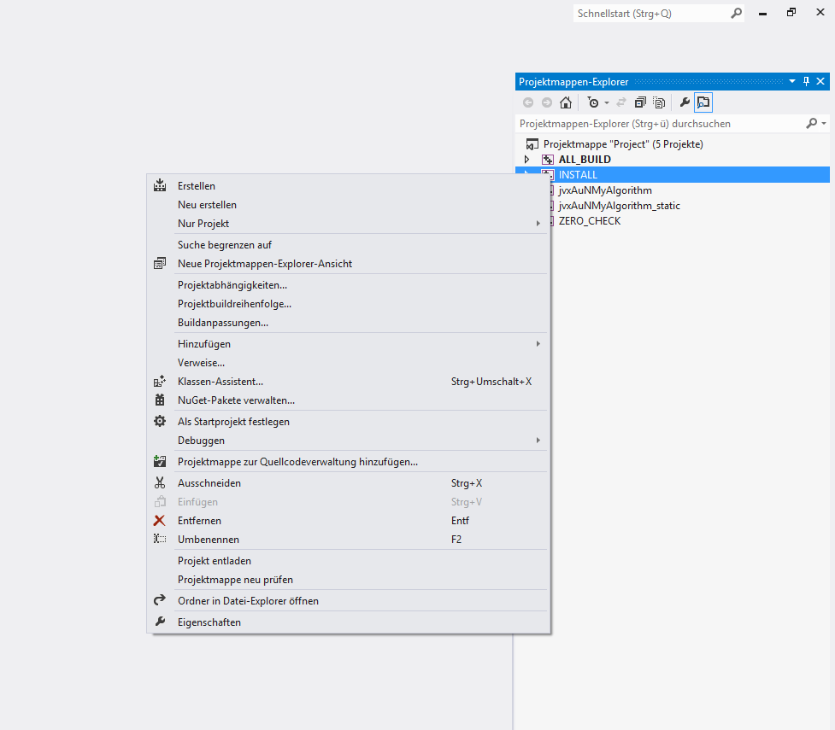
Preparation of the Template Project (I)
In Visual Studio
Right-click on the INSTALL project, then select
Erstellen/Build
„Build“ is more than just build!

Slide 25
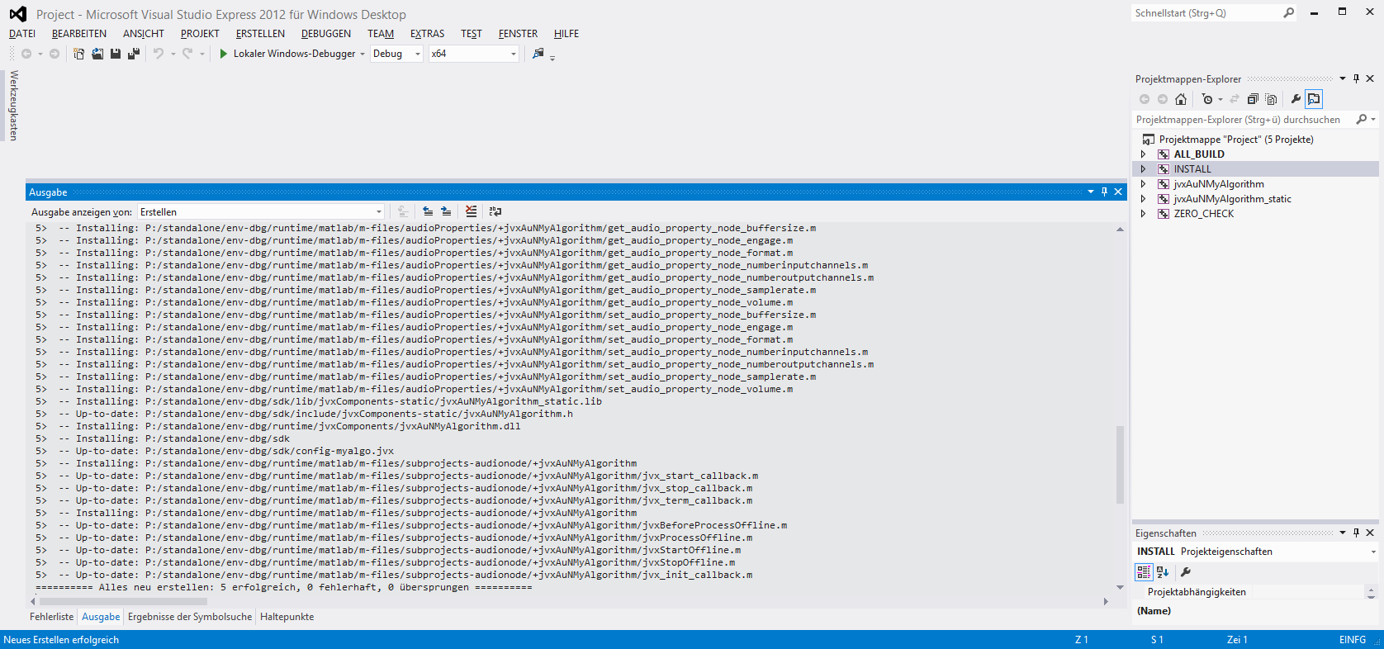
Preparation of the Template Project (II)
Let us Review the Build Output

Slide 26
Preparation of the Template Project (III)
What Happens During Install Procedure
Runtime Environment
User Project
SDK Environment
Installation of dynamic library to Runtime
Installation of Hooks for Matlab to Runtime
Installation of static library and header files to SDK

Slide 27

Part III
1
First Matlab Implementation

Slide 28
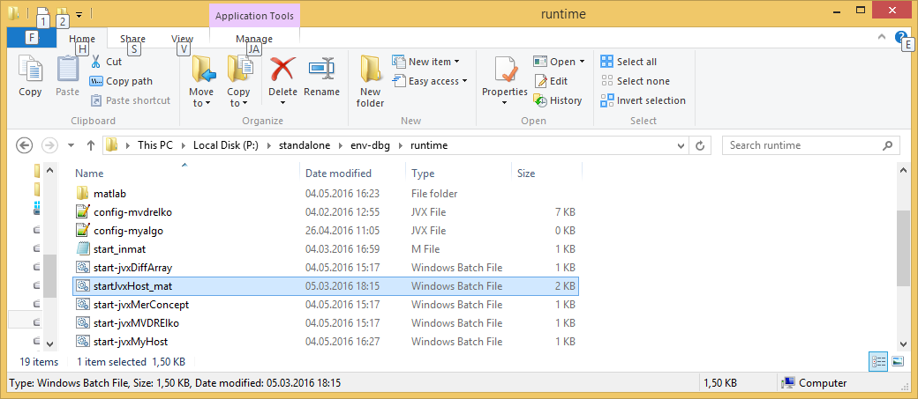
First Implementation of the New Algorithm in Matlab
Start Matlab Host in the Runtime Environment
Double-click Matlab start script
Runtime Environment

Slide 29
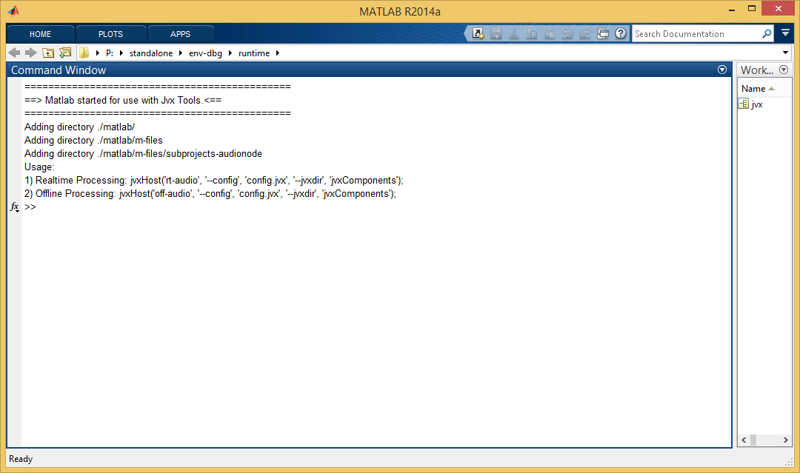
RTProc Host in Matlab Environment (I)
Matlab Starts and Shows User Options

Slide 30
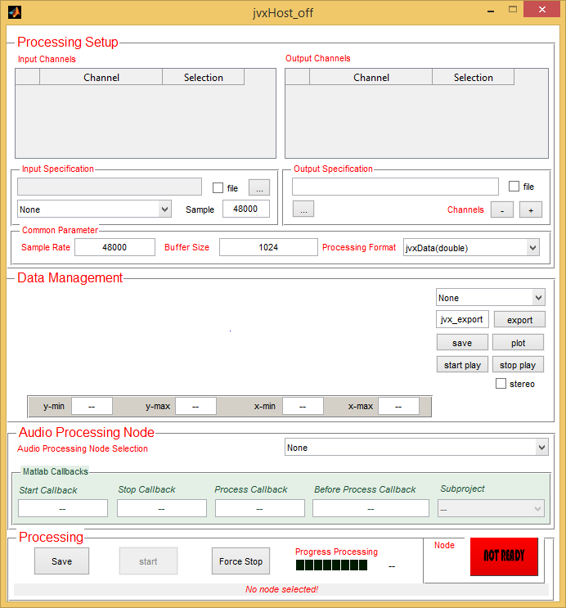
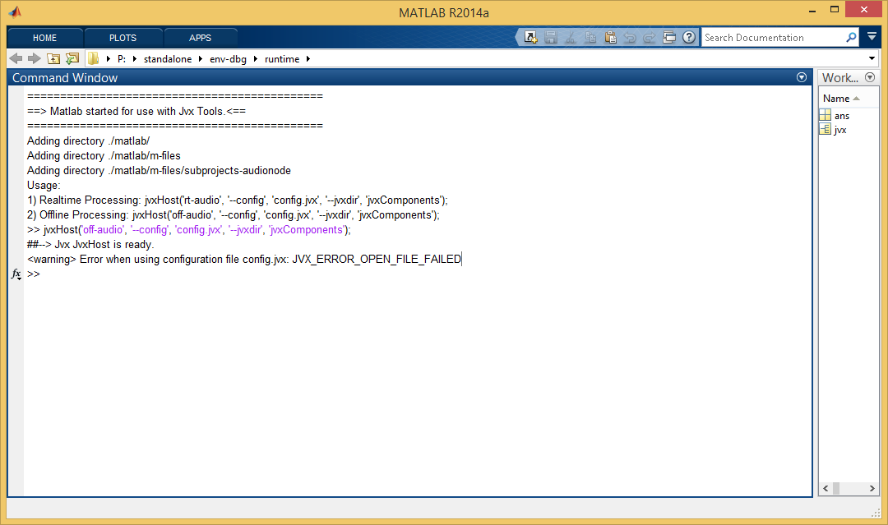
RTProc Host in Matlab Environment (II)
Start Offline Host at First: jvxHost('off-audio', '--config', 'config.jvx', '--jvxdir', 'jvxComponents');

Slide 31
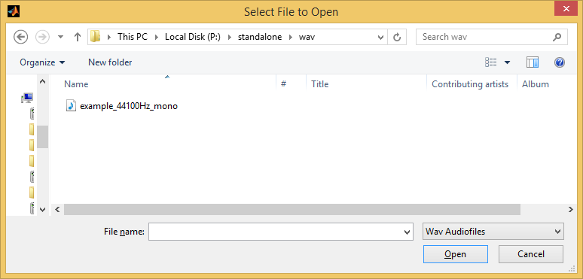
RTProc Host in Matlab Environment (III)
Select Input File

Slide 32
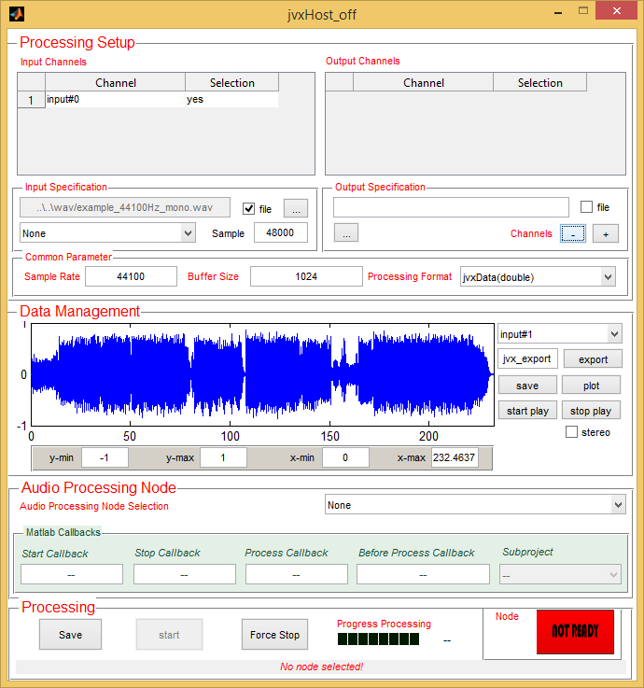
RTProc Host in Matlab Environment (IV)
Input File is Ready
1
Single channel input
Processing parameters
Waveform
Listen to the music!
2
3
4

Slide 33
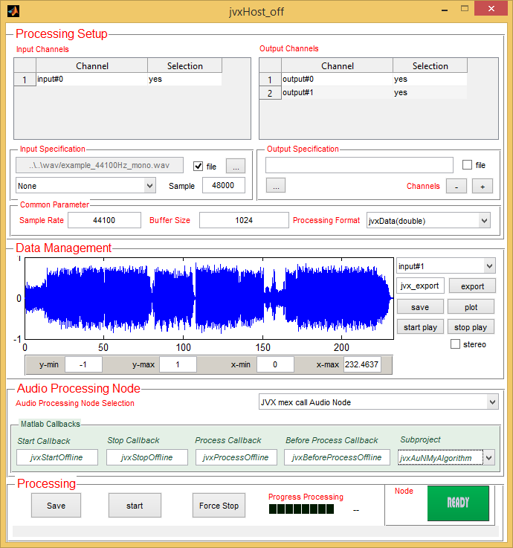
RTProc Host in Matlab Environment (V)
Specify Output Signal
Add Channels (here: +2)
Activate Generic Matlab Project
1
„JVX mex call Audio Node“
Setup Matlab Callbacks
„jvxAuNMyAlgorithm“
2
3

Slide 34
RTProc Host in Matlab Environment (VI)
Save Configuration
„Save“ button
Restart host
WE NEED TO RESTART THE HOST TO PREPARE THE ENVIRONMENT TO MATCH THE CONFIGURATION FILE!!
1

Slide 35
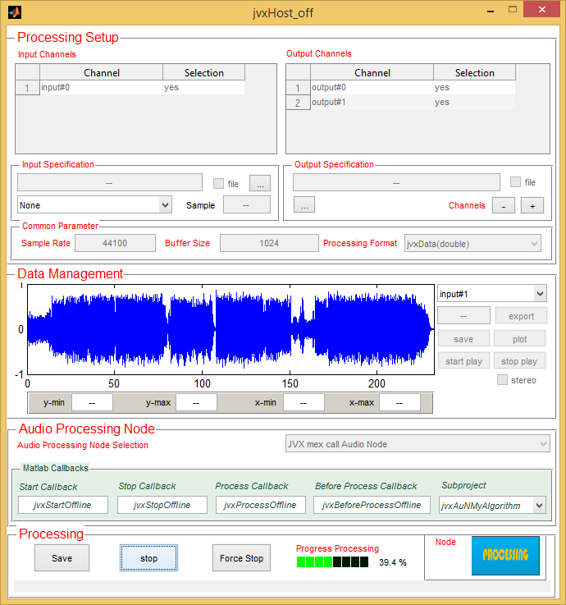
RTProc Host in Matlab Environment (VII)
Run Processing Algorithm
Push start
Progress bar indicates progress
1
2

Slide 36
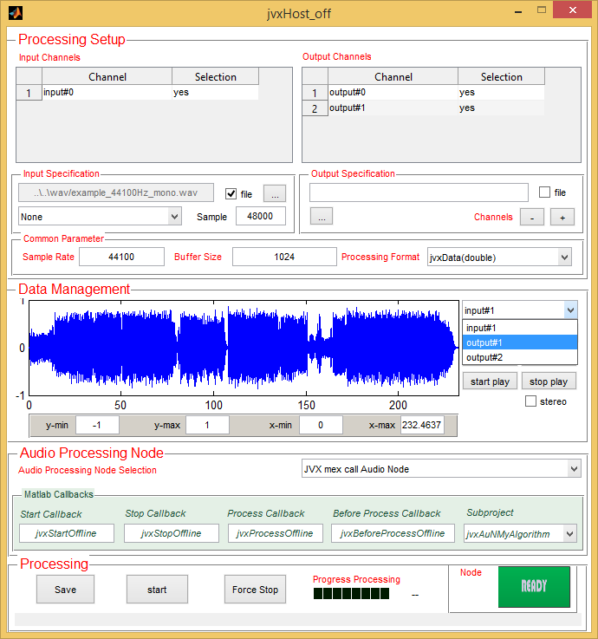
RTProc Host in Matlab Environment (VIII)
Let us Review the Output
Two additional channels available

Slide 37
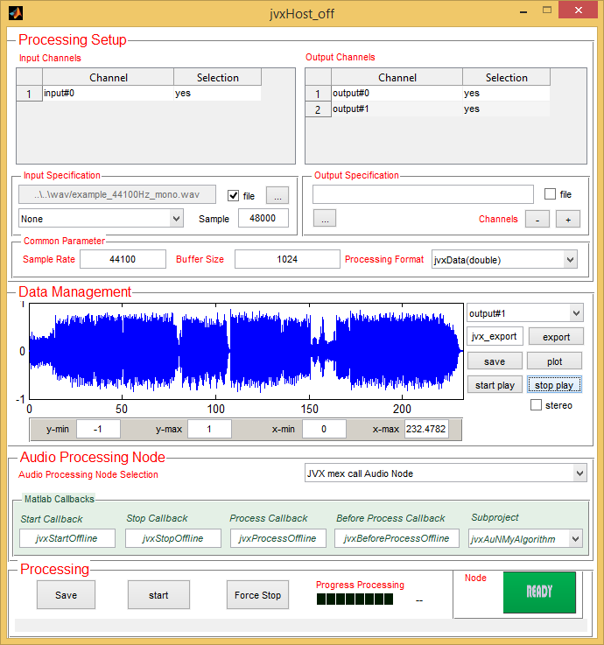
RTProc Host in Matlab Environment (IX)
We may..
Export channels to workspace
Save channel to file
Plot the channels in a separate plot diagram
Listen to the processed output
1
2
3
4

Slide 38
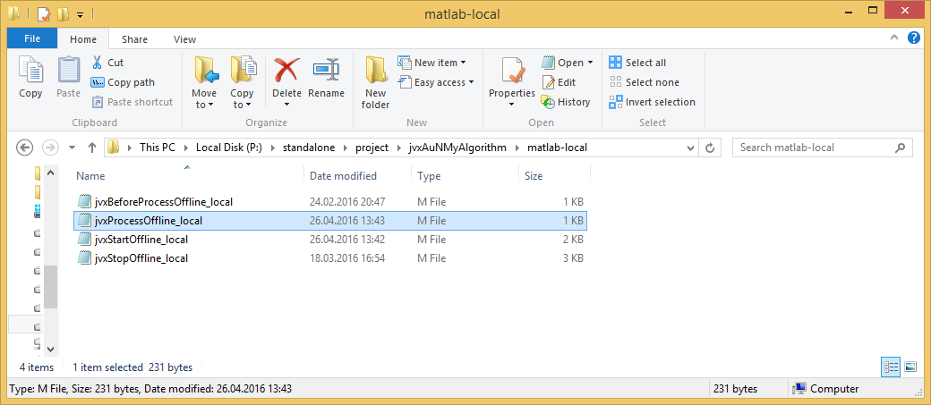
RTProc Host in Matlab Environment - Explained
What we Actually Did…
Data flow diagram

Slide 39
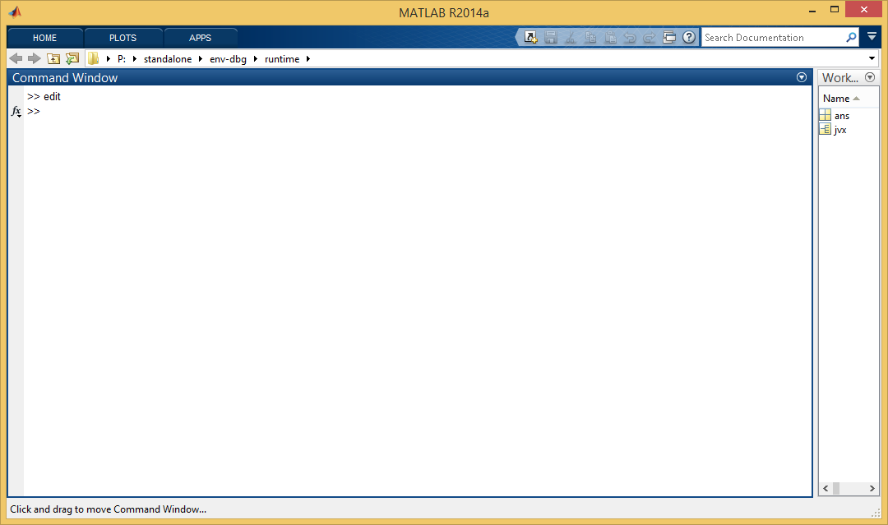

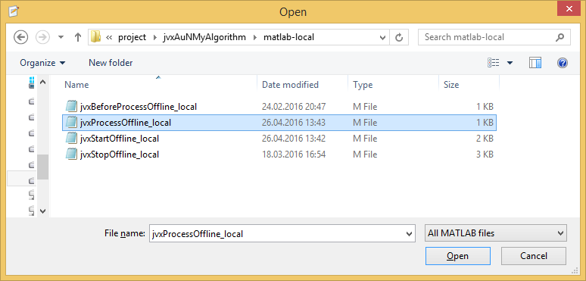
RTProc Host in Matlab Environment – Debug (I)
Debugging Signal Processing
1
Open File in Matlab Editor
2
3

Slide 40
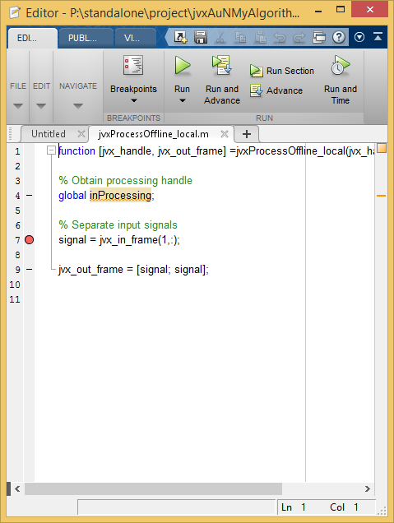
RTProc Host in Matlab Environment – Debug (II)
Setting a Breakpoint
Request to stop in processing callback
Restart processing
1
2

Slide 41
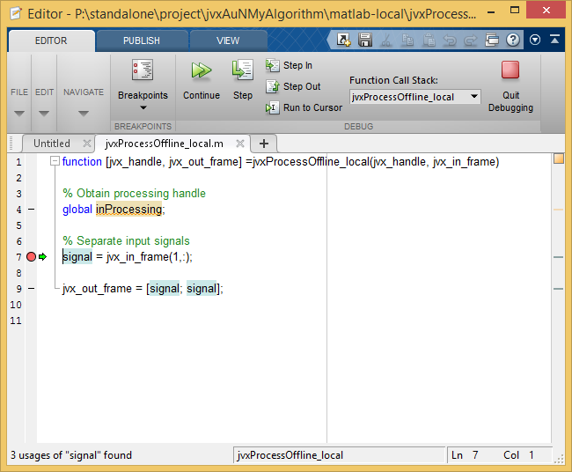
RTProc Host in Matlab Environment – Debug (II)
Stepping Through the Code

Slide 42
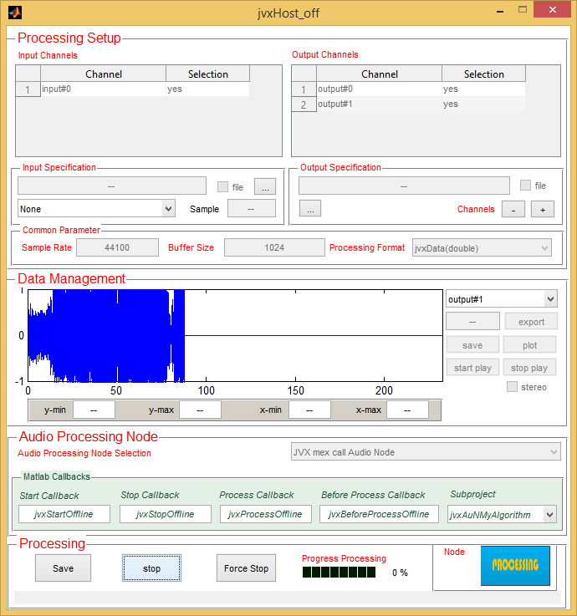
RTProc Host in Matlab Environment – Debug (III)
How to Cleanly Stop Debugging
2
1

Slide 43
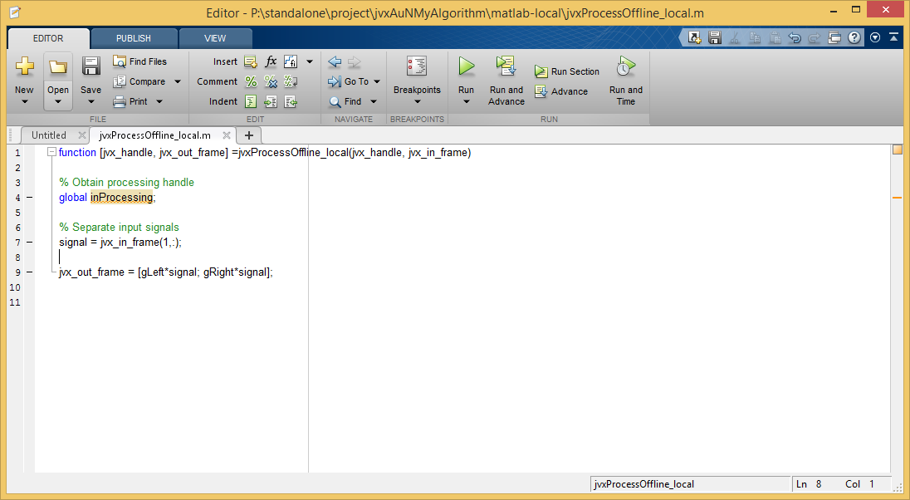
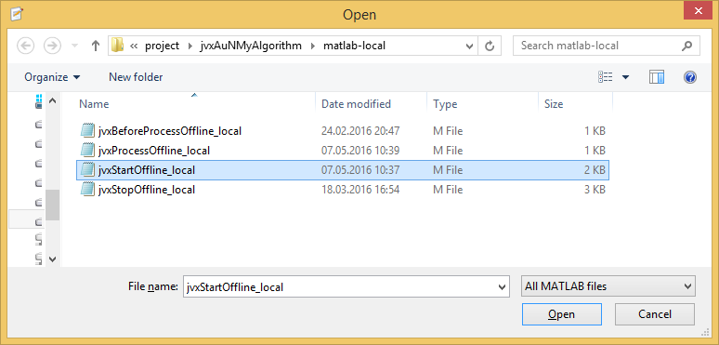
RTProc Host in Matlab Environment – Left-Right-Panning (I)
Specifying the Processing Configuration
Right place: implementation of callback called before processing starts: jvxStartOffline_local

Slide 44
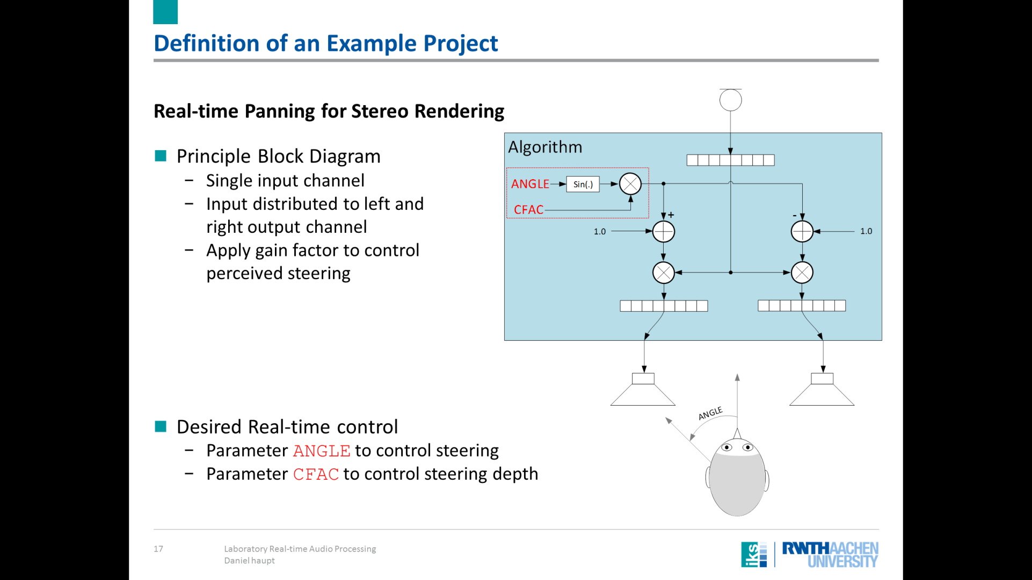
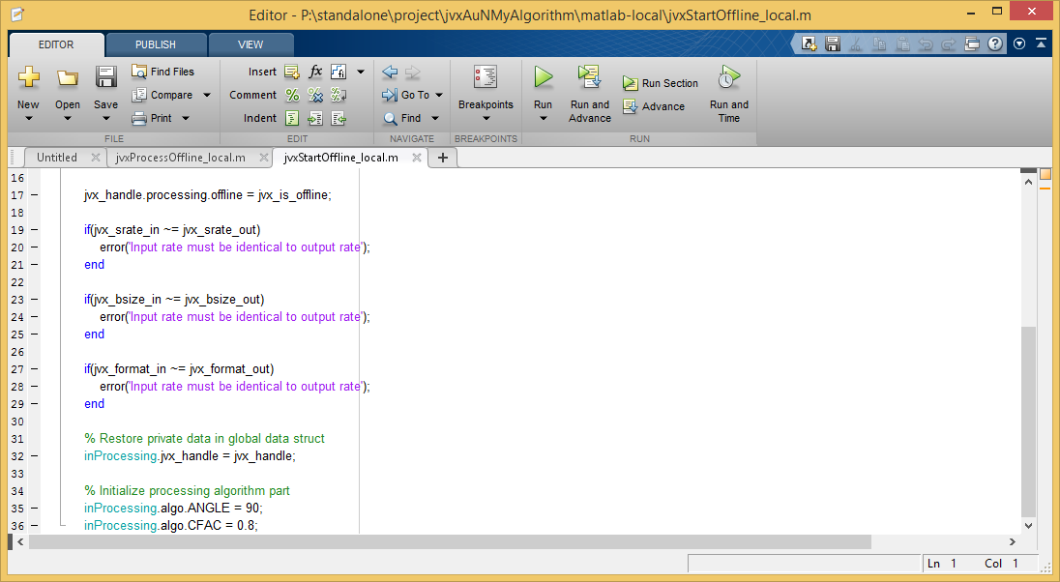
RTProc Host in Matlab Environment – Left-Right-Panning (II)
Initialization of Processing Parameters
Add parameter ANGLE and CFAC to global variable inProcessing
Set initial values

Slide 45
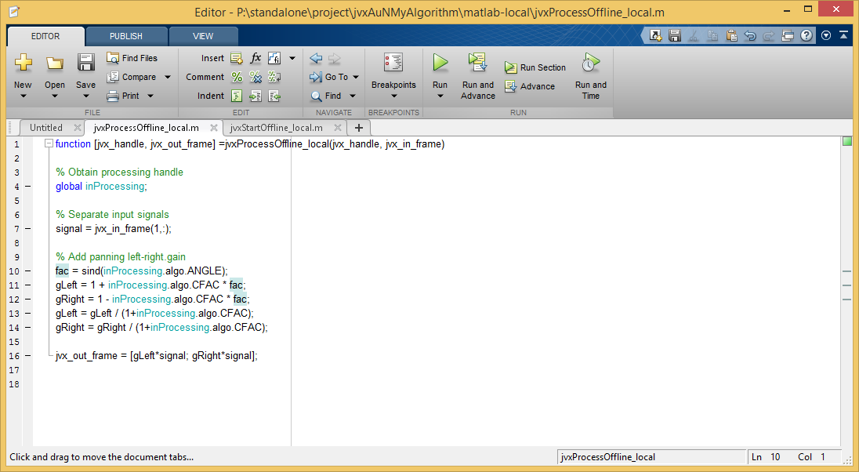
RTProc Host in Matlab Environment – Left-Right-Panning (III)
Modify Signals in Processing Loop
Compute channel specific gain factors
Apply to each channel

Slide 46

RTProc Host in Matlab Environment – Left-Right-Panning (IV)
Listen to the Output
Use a Headphone!

Slide 47
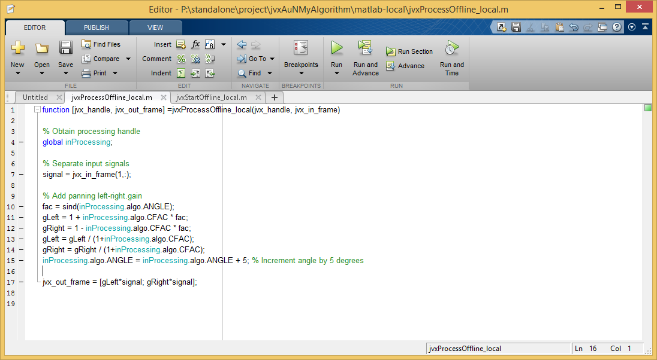
RTProc Host in Matlab Environment – Left-Right-Panning (V)
„Circulating“ the Input Source

Slide 48

RTProc Host in Matlab Environment – Left-Right-Panning (VI)
Listen to the Output
Use a Headphone!

Slide 49
RTProc Host in Matlab Environment – Left-Right-Panning (VII)
Shutting Down the Host
Just close the figure

Slide 50
Part IV
2
Real-time Matlab Implementation

Slide 51
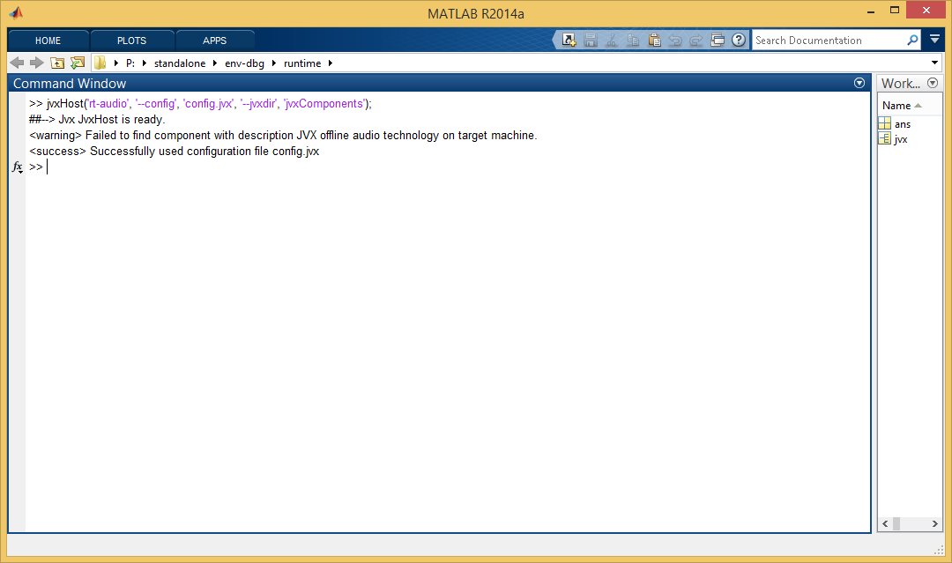
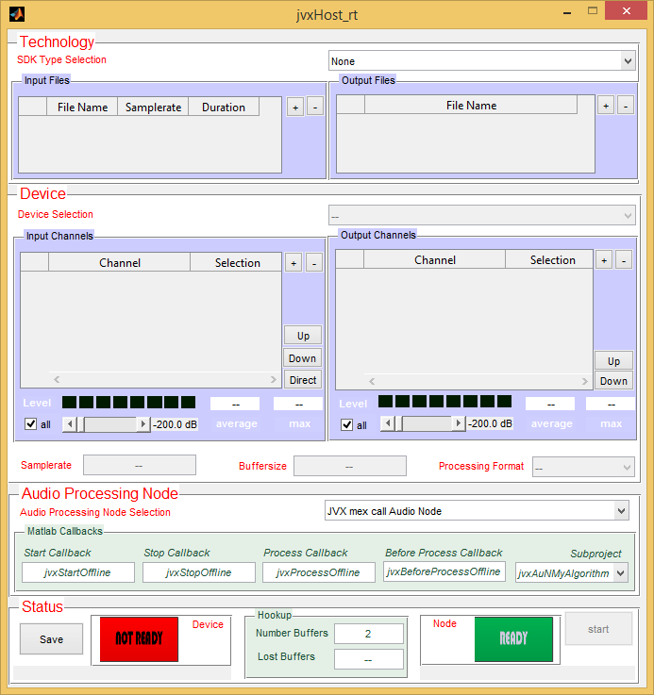
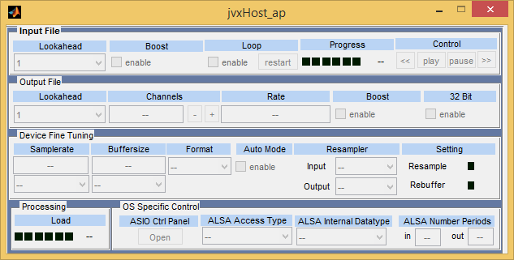
RTProc Matlab Host for Real-time Processing
!! STOP OFFLINE MATLAB HOST BEFORE YOU START THE REAL-TIME HOST !!
Start Real-time Host jvxHost('rt-audio', '--config', 'config.jvx', '--jvxdir', 'jvxComponents');

Slide 52

RTProc Host in Matlab Environment - Explained
What we Plan to Realize
Data flow diagram

Slide 53
RTProc Matlab Host for Real-time Processing - Configuration
Real-time Host very Similar to Offline Host
The good thing: we use the same configuration file as before
The bad Thing: we need to configure the audio device
2
1

Slide 54
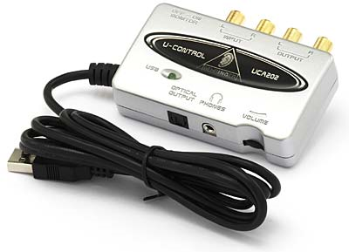
RTProc Matlab Host for Real-time Processing – The Used Hardware
Hardware Setup
Soundcard in use: Behringer UCA 202
2 Input Channels
2 Output Channels
Medium Quality Audio I/O
Low Price!
ASIO Driver available
Device to rated as „ok for most applications“

Slide 55
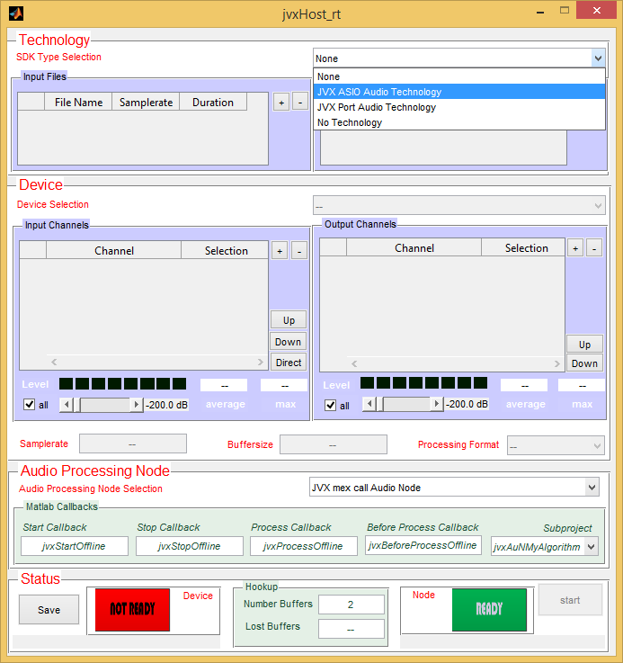
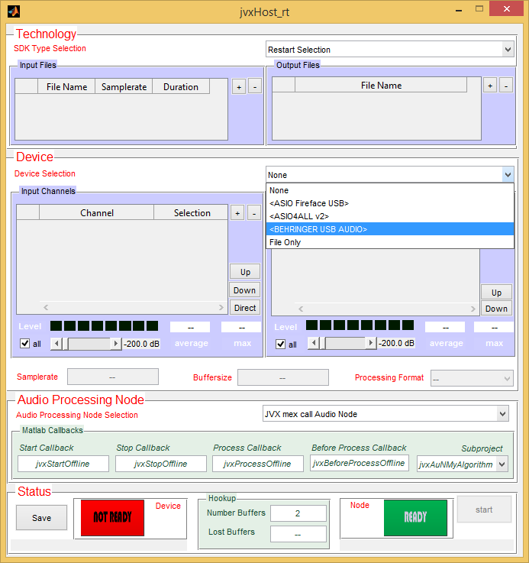
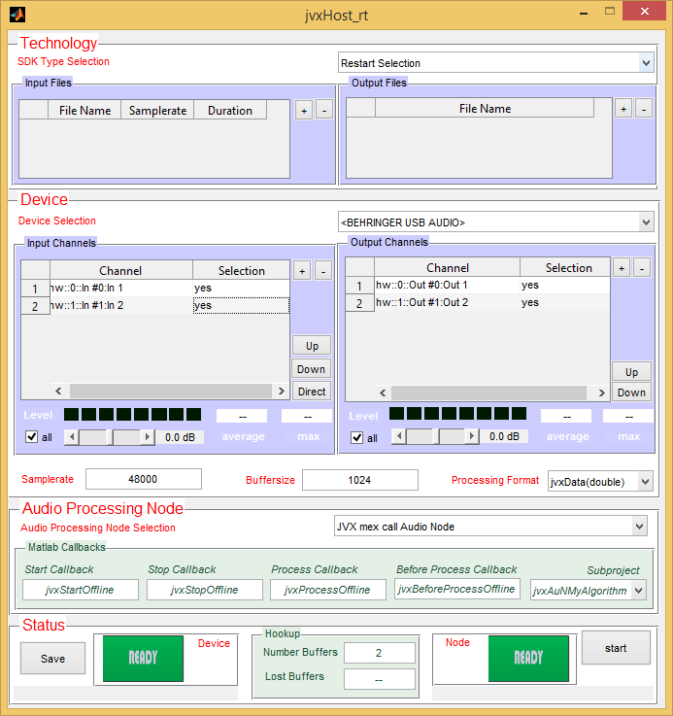
RTProc Matlab Host for Real-time Processing – Hardware Setup (I)
Configure Technology and Device
1
Select „JVX ASIO Audio Technology“
Select „BEHRINGER USB AUDIO“
2
2 input channels & 2 output channels available

Slide 56

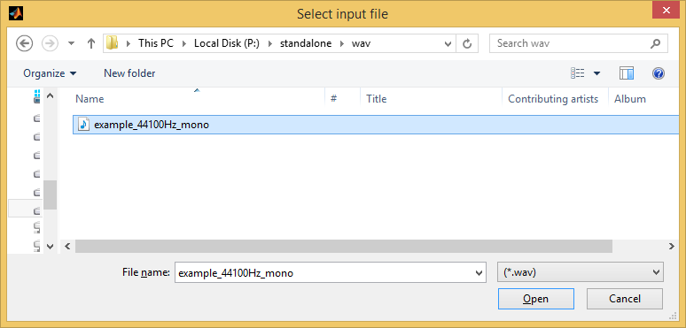
RTProc Matlab Host for Real-time Processing – Hardware Setup (II)
Let us make Life a Little More Easy
There is no external data source connected to the USB soundcard
Let us use a „file input channel“ instead of a real input channel
1
2

Slide 57

RTProc Matlab Host for Real-time Processing – Hardware Setup (III)
Choose „Virtual Input Channel“ as Input for Panning
File is listed in „Input Files“
Corresponding channels are listed in „Input Channels“
Only the „virtual input channel“ should be active
1
3
2
Ready for processing

Slide 58
RTProc Matlab Host for Real-time Processing – Hardware Setup (IV)
Start Processing
Connect a headphone
Push the „start“ button
1
Matlab runs in real-time!!
2

Slide 59

RTProc Matlab Host for Real-time Processing
Conclusion
Matlab operates in real-time!
Hear some artefacts from time to time due to losses of frames – in case user moves windows around
Artefacts due to lost buffers – which cannot be prevented due to single threading only in Matlab
We better switch to C/C++!!
2
Do not forget to shutdown real-time Matlab host!!

Slide 60
Part V
2
Offline C/C++ Implementation

Slide 61
First Implementation of the New Algorithm in C/C++
Start Matlab Host in the Runtime Environment
Double-click Matlab start script
Runtime Environment

Slide 62

RTProc Host in Matlab Environment, C/C++ Implementation (I)
Start Offline Host at First: jvxHost('off-audio', '--config', 'config.jvx', '--jvxdir', 'jvxComponents');
C/C++ implementation at first to be evaluated within Matlab Environment

Slide 63

RTProc Host in Matlab Environment, C/C++ Implementation (II)
In Matlab Host, Select C/C++ Version of New Algorithm
Component „My New Algorithm“
Let us see how that links to the project!

Slide 64

C/C++ Programming Explained (I)
What we Plan to Do
Data flow diagram

Slide 65

C/C++ Programming Explained (II)
Let us Review some Code
Signal processing functionality encapsulated by C++ class
Processing class derived from existing class CjvxAudioNode

Slide 66
C/C++ Programming Explained (III)
Inheritance Graph
Class CjvxAuNMyAlgorithm: Place for your Algorithm!
Default Implementation: Talkthrough
System API
Principally: no need to write a single line of code to start!

Slide 67

C/C++ Programming Explained (IV)
Main Purpose of the CjvxAuNMyAlgorithm class: signal processing
Principle
In Detail
Slightly modified for higher efficiency

Slide 68

C/C++ Programming Explained (V)
Let us Review the Core Signal Processing
In function process_st: copy input to output
copy input to output
Need to define only those function deviating from default behavior
How does this integrate into a full signal processing application?

Slide 69
C/C++ Programming Explained (IV)
Matlab host Driving the Algorithm Component
Data source and data source are Matlab workspace variables

Slide 70

C/C++ Programming Explained (V)
What are the other Functions Good for?
One callback for each user action based on state machine
„activate“ algorithm
„deactivate“ algorithm

Slide 71

C/C++ Programming Explained (VI)
RTProc State Machine
States and state transitions
equivalent
Play-pause-rec
Play-rec

Slide 72

RTProc Host in Matlab Environment, Running the C/C++ Code
Enough Explanations, Let’s Go
Process input signal
Current functionality: talkthrough

Slide 73

RTProc Host in Matlab Environment, Debugging C/C++ Code (I)
Set Breakpoint
In function process_st(..) by clicking to the breakpoint area
click

Slide 74


RTProc Host in Matlab Environment, Debugging C/C++ Code (II)
Set Breakpoint
Attach Matlab to Visual Studio

Slide 75
RTProc Host in Matlab Environment, Debugging C/C++ Code (III)
Running Processing Again
Push start

Slide 76

RTProc Host in Matlab Environment, Debugging C/C++ Code (IV)
Tada…
Breakpoint is hit, go ahead, step through the code,
F10: step; F11:step into; F5: continue; Shift-F5: detach

Slide 77

RTProc Host in Matlab Environment, C/C++ Modifications (I)
Modification I: Let us Rename the Algorithm
We rename it to „My First Left-right-panner“
File componentEntry.cpp,
Build afterwards

Slide 78

RTProc Host in Matlab Environment, C/C++ Modifications (II)
Argh, a Compilation Error
Matlab Host „locks“ the algorithm dynamic-link-library
Save & close Matlab host GUI first, compile and restart afterwards

Slide 79

RTProc Host in Matlab Environment, C/C++ Modifications (III)
New Version of Algorithm Selectable in Matlab Host now!

Slide 80


RTProc Host in Matlab Environment, C/C++ Modifications (IV)
Actual Implementation of the Left-right-Panning
Code modification in function process_buffer
Compute left-right-gains
Apply left-right-gains

Slide 81

RTProc Host in Matlab Environment, C/C++ Modifications (VI)
Mh, this is not a Perfect Solution yet
Modification of ANGLE requires algorithm rebuild
Let us use the RTProc property system

Slide 82
Using the RTProc Property System (I)
How it works
Class CjvxAudioNode derived also from class CjvxProperties

Slide 83

Using the RTProc Property System (II)
Defining Properties for My Algorithm
RTProc code generation tools: The Property Code Generator (PCG)
Where to find that exports_node.pcg file?

Slide 84

Using the RTProc Property System (III)
Specification of the Required Parameters
Dedicated but very easy to use text format

Slide 85

Using the RTProc Property System (IV)
Required Code Change in Our Algorithm (Header File)
Derive from code-generated class to inherit all properties

Slide 86

Using the RTProc Property System (V)
Required Code Change in Our Algorithm (Source File)
On algorithm activation: allocate and register all properties
On algorithm deactivation: unregister and deallocate all properties

Slide 87

Using the RTProc Property System (VI)
Property Access Entry Points in Matlab
Access functions generated for all specified properties

Slide 88


Using the RTProc Property System (VII)
Reading Properties from within Matlab
Get value for ANGLE
jvxAuNMyAlgorithm.get_audio_property_node_ANGLE;
Get value for CFAC
jvxAuNMyAlgorithm.get_audio_property_node_CFAC;

Slide 89

Using the RTProc Property System (VIII)
Writing Properties from within Matlab
Set value for ANGLE
jvxAuNMyAlgorithm.set_audio_property_node_ANGLE(-90);
Set value for CFAC
jvxAuNMyAlgorithm.set_audio_property_node_CFAC(0.95);

Slide 90

Using the RTProc Property System (IX)
Possible to Modify Properties in Real-time?
Of course, just use the real-time version of the host (refer to here)

Slide 91

Using the RTProc Property System (X)
Here is a Funny Little Code Fragment for Moving Source from Right to Left
Just run it while real-time processing operates!

Slide 92
Part VI
3
Highly Efficient C/C++ Implementation

Slide 93

Option I: Use an Existing Host Application (I)
We May Run Our Algorithm in an Existing Host Implementation
Start host by double-clicking
start-jvxRtprocHost

Slide 94

Option I: Use an Existing Host Application (II)
Hosts Loads all Components by Opening Dynamic Link Libraries

Slide 95

Option I: Use an Existing Host Application (III)
Select the New Left-right-Panning Algorithm

Slide 96

Option I: Use an Existing Host Application (IV)
Hardware Configuration Dialog

Slide 97


Option I: Use an Existing Host Application (V)
Find configuration as we did here

Slide 98


Option I: Use an Existing Host Application (VI)
Once ready, start Processing

Slide 99

Option I: Use an Existing Host Application (VII)
How can we modify the ANGLE parameter??
We need to CUSTOMIZE the User Interface!
Remember the second project?

Slide 100


Option II: Develop a Customized Host (I)
Principle Idea of the Customized Host
A non-custom host is extended by single "custom widget“

Slide 101

Option II: Develop a Customized Host (II)
Build Your Custom Host Template
Open Visual Studio Command Prompt
Go to folder
build-host

Slide 102

Option II: Develop a Customized Host (III)
Create the Visual Studio Solution
Run cmake build script
compile_host.bat

Slide 103

Option II: Develop a Customized Host (IV)
Open Visual Studio
Double-click new Visual Studio Solution
Project.sln

Slide 104
Option II: Develop a Customized Host (V)
In Visual Studio
Right-click on the INSTALL project, then select
Erstellen/Build

Slide 105

Option II: Develop a Customized Host (VI)
The Build Output

Slide 106

Option II: Develop a Customized Host (VII)
First Version of Customized Host is Ready!
Start by double-click

Slide 107

Option II: Develop a Customized Host (VIII)
Host Application with Custom User Interface
Looks almost as the non-customized host
Drives only ONE specific algorithm

Slide 108

Integrate the Required Modifications (I)
Starting the QT Designer
Enter “Designer” in Windows search

Slide 109


Integrate the Required Modifications (II)
Required in Designer: Elements to set the ANGLE and the CFAC Parameters
Open existing widget project myMainWidget.ui

Slide 110

Integrate the Required Modifications (III)
Add QLineEdit Instances for Parameter Modifications
Drag-And-Drop form left side selection

Slide 111

Integrate the Required Modifications (IV)
Give Useful Names for the QLineEdits
Names of QLineEdits will be used in source code later on
lineEdit_ANGLE and lineEdit_CFAC

Slide 112

Integrate the Required Modifications (V)
Define Callbacks to Catch User Interaction
Callbacks for user interaction are denoted as „slots“
Right-click into widget space

Slide 113

Integrate the Required Modifications (VI)
Provide useful Name for the Slots

Slide 114

Integrate the Required Modifications (VII)
Link User Interaction Events to Slots

Slide 115

Integrate the Required Modifications (VIII)
Add Slot Definitions in Source Code (Header)

Slide 116

Integrate the Required Modifications (IX)
Add Slot Definitions in Source Code (Source File)
Read out QLineEdit, transform content into arithmetic value (double)

Slide 117

Integrate the Required Modifications (X)
Add Slot Definitions in Source Code (Source File)
Pass the values to signal processing algorithm

Slide 118

Integrate the Required Modifications (XI)
Final Step: Read Values to View in User Interface (Header File)
Define function inform_update_window

Slide 119

Integrate the Required Modifications (XII)
Final Step: Read Values to View in User Interface (Source File)
Implement function inform_update_window

Slide 120

Integrate the Required Modifications (XIII)
Finally: Let us Centralize UI Window Show Management
React to User input by redrawing everything

Slide 121

Standalone Real-time Host is Complete
We are Done!!!

